Slide 1
CSYE 7280 - User Experience Design and Testing
Instructor: Vishal Chawla

Slide 2
User Experience and testing
This user experience course/discipline is an art and involves lot of creativity, brainstorming, analysis, Wireframing, Prototyping and user interaction. It involves usability testing and other techniques to understand user behavior
  CSYE7280.User Experience Design and Testing
    By Prof Vishal Chawla

Slide 3
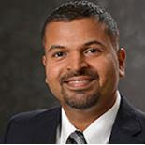
Mug Shot and Bio
Vishal Chawla is a Senior Web Design and Development Lead/manager at the MIT Lincoln Labs which is based in Lexington, MA. He leads a team of User Experience, Web Development, Application Development and Quality Assurance engineers in his current role. He has more than 20 year of experience in the field of technology and technical management. Along with that he has an interest in teaching technical courses at reputed university as he believes that the best way to learn is to teach. His teaching style is very practical, industry oriented that help student develop necessary skills that will help them succeed in their career.
LinkedIn Profile: https://www.linkedin.com/pub/vishal-chawla/1/398/35b

Slide 4
Course Description
Introduces User Experience concepts while working on Web projects. Course offers students an opportunity to build the necessary skill sets to make better decisions of the best way to design contemporary websites that cater to customer needs. The students have an opportunity to practice interview techniques to understand user requirements while keeping user experience central to the effort. Wire frames and user scenarios are used to drive the creative design process. Various case studies are introduced and discussed in team settings to emphasize user perspectives. Quality assurance and usability testing are used to drive validation and user-acceptance testing and approvals.
Prerequisite: This class assumes no prior experience in the User Experience design and User Experience testing concepts. Web programming experience is helpful but is not required. Comfort with computers, desktop tools and general computing concepts are expected.

Slide 5
Course Objective
Understand the User Experience concepts and importance of making usable websites or products
Understand the importance of gathering user requirements early on during the design phase of the project
Learn Wireframe tools and techniques
Learn how to test the products or websites with usability in mind
Learn about the visualization concepts
Develop and display critical thinking and analytical skills through presentations
Learn with using group discussions in a friendly setting
Learn Quality Assurance techniques and basic understanding of automation tools like Selenium
Apply the knowledge readily to the next assignment or job

Slide 6
Course Schedule: (Subject to change)
Class 1 | Course Outline and Introductions Introduction to the User Experience Concepts Videos and Class discussions
Class 2 | Techniques to gather User requirements using User Experience concepts Wire framing techniques and Wireframe tools Wire framing techniques and Wireframe tools using Mocqups tool
Class 3 | The Elements of User Experience (discussion from that book from Jesse James Garett) Web Design concepts and principles of User Experience
Class 4 | Information Architecture The Elements of User Experience (continue discussion from that book from Jesse James Garett)
Class 5 | Wire frame using Balsamiq tool Rocket Surgery Made Easy by Steve Krug
Class 6 | Student presentations on the Wire frame design
Class 7 | Quizzes/Mid Term Presentation Advanced Website Design and concepts, Project Assignments Discussion

Slide 7
Course Schedule: (Subject to change)
Class 8 | Human Factored Design Storyboarding techniques
Class 9 | Discussion on the best and worst websites Group discussion Usability Testing
Class 10 | IBM Design Thinking Case Study Quality Assurance
Class 11 | Google Material Design Guest Speaker Introduction and basic techniques for Automation testing Final Project discussion and clarifications
Class 12 | Prototyping techniques Introduction to Axure tool Case Study
Class 13 | User Experience testing as part of overall Quality Assurance Prototyping techniques Introduction to Figma tool
Class 14 | Project Presentations

Slide 8
Recommended Text
1. The Design of Everyday Things by Don Norman (ISBN-10: 0465050654).
2. Don't Make Me Think, Revisited: A Common Sense Approach to Web Usability by Steve Krug (ISBN-13: 978-0321965516)
3. Articles from Nielson Norman Group (http://www.nngroup.com/articles/)
4. Web Development and Design Foundations with HTML5 by Terry Felke-Morris (ISBN-13: 9780133571783)
5. User-Centered Web Site Development: A Human-Computer Interaction by Daniel D. McCracken (ISBN-13: 9780130411617)

Slide 9
Final Project
The final projects will be completed by a team of 5-6 students. The project details will be provided during the second/third week of the course. Students are encouraged to choose their topic of choice either from healthcare, business, and/or technology related fields. Details on project deliverable requirement will be specified later.

Slide 10
Grading
Grading:
    Assignments – 25 %
    Quizzes – 25%
    Midterm Presentation - 20%
    Final Project - 20%
    Class Participation/Creativity – 10%

Slide 11
Academic Honesty
The Northeastern University academic integrity policy applies to your work in this course. All students are expected to adhere to this policy. For more information on academic integrity policy, please visit
website: http://www.northeastern.edu/osccr/academicintegrity/index.html
Facilitating academic dishonesty – Examples may include inaccurately listing someone as co-author of Paper who did not contribute, sharing a take-home exam, or taking an exam or writing a paper for another student.

Slide 12
Attendance policy
The department has a strict class attendance policy.
Prior permission is needed to miss any class else student who miss two or more classes will automatically receive one letter grade lower in their final grade.

Slide 13
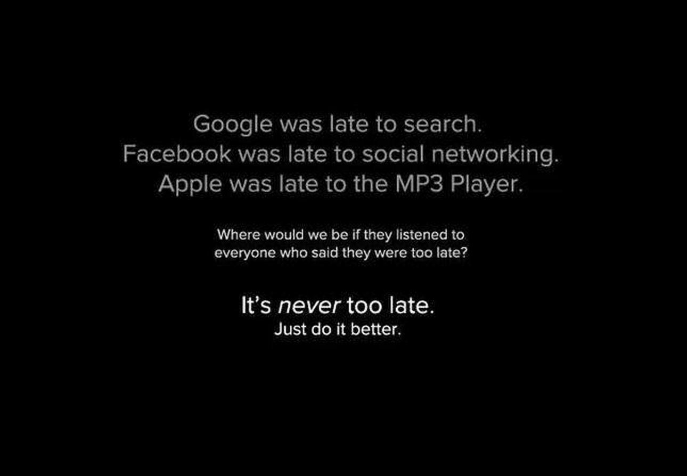

Slide 14
How Good Design makes you Happy https://www.youtube.com/watch?v=RlQEoJaLQRA
Jacobs Law of Internet
  https://www.nngroup.com/videos/jakobs-law-internet-ux/?autoplay

Slide 15
Class Discussion – 30 Min
1) What is User Experience means to you & why is it important?
2) For websites/products or services, what should they have for a good user experience to their users/customers?

Slide 16
Use Cases
https://www.usability.gov/how-to-and-tools/methods/use-cases.html

Slide 17
Class Exercise (Website Comparison) – 30 min
As a group, take a pair of website below and compare their user experience. List out all the good and bad points in terms of the user experience and practice some writing some use cases for the improvements
  Amazon vs Wayfair
  Walmart vs Target
  Facebook vs Twitter
  Shopify vs Costco
  Apple vs Microsoft
  Indeed vs Glassdoor, or Indeed vs LinkedIn

Slide 18
Assignment 1
1) Keeping the class exercise in mind do the following:
Take any product, system or service you use everyday like iPhone, Fitbit, MBTA, Amazon, Google, Reddit, News Website etc. Explain what user experience aspects of that product that you liked! Then list what significant improvements you would suggest!
2) Create the use cases for the interactions assuming the improvements of the site in mind.
Be creative and even if that means rethinking or recreating that product, system and service.
3) Read Chapter 1-3 of the “The Elements of User Experience by Jesse James Garett” for class discussion in next class
4) Go to https://moqups.com/ and create an account using Northeastern email address. TA will upload an excel sheet for you to add these details to the sheet so your account can be added to the project.

